Slide 1
Introducing ML.NET
Sathish Nadarajan, SharePoint Architect,
@contactsathish

Slide 2

Agenda
What is Machine Learning
Machine Learning process
ML.Net
What is a Model
How to consume the Model
Demo
Issue Classification
Prediction of Titanic Survivors
Road ahead of ML.Net

Slide 3

What is Machine Learning?
Data Science technique, which allows the computers to use the existing data to forecast the future trends.
Branch of computer science in which a computer "learns" from data in order to perform predictive analytics
Credit-card fraud detection
Online shopping recommendations
Self-driving cars and more
Machine Learning finds patterns in large volumes of data and uses those patterns to perform predictive analysis
Supervised learning
Regression and classification
Unsupervised learning
Clustering
Notes:
1. Machine Learning finds patterns in large volumes of data and uses those patterns to perform predictive analysis.
2. Machine learning models fall into two broad categories:
supervised and unsupervised.
3. In supervised learning, the model is "trained" with a large volume of data and algorithms are then used to predict an outcome from future inputs. Most supervised learning models use regression algorithms to compute an outcome from a continuous set of possible outcomes (for example, your score on a test), or classification algorithms to compute the probability of an outcome from a finite set of possible outcomes (for example, the probability that an e-mail is spam or a credit-card transaction is fraudulent).
4. In unsupervised learning, the computer isn't trained, but is presented with a set of data and challenged to find relationships in it. K-Means Clustering is a common unsupervised learning algorithm. For a great explanation of how it works, see https://blog.intercom.io/machine-learning-way-easier-than-it-looks/.

Slide 4
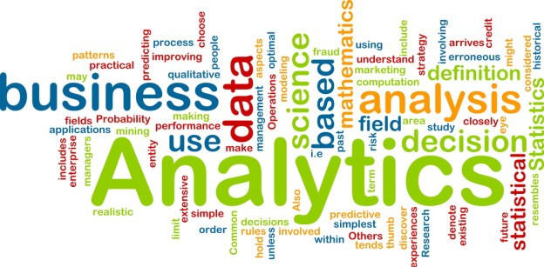
Analytics
Descriptive Analytics
Diagnostic Analytics
Predictive Analytics
Prescriptive Analytics
Notes:
Descriptive Analytics – What happened
Diagnostic Analytics – Why did it happen
Predictive Analytics – What will happen
Prescriptive Analytics – How can we make it happen

Slide 5
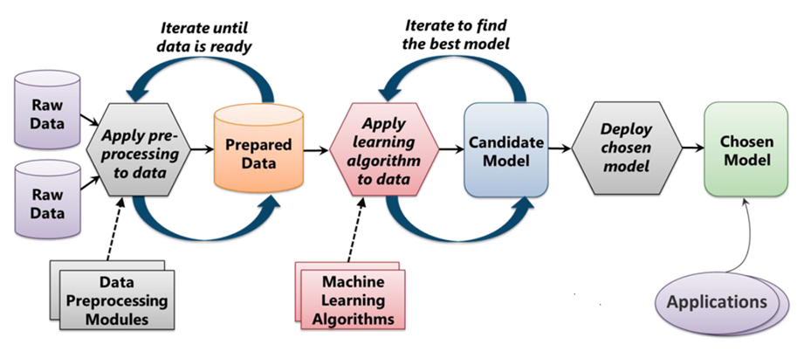
The Machine Learning Process
From "Introduction to Microsoft Azure" by David Chappell
Notes:
ML starts with data, which can come from a variety of sources. The data typically needs to be "cleaned" before it is used, and ML Studio includes modules to help with the cleaning. (Examples of cleaning include removing rows with missing data, replacing missing data algorithmically, removing duplicate rows, and removing rows containing "outliers." In practice, cleaning the data can be very time-intensive and often consumes 50% of the time required to build the model.) Once the data is ready, you select an algorithm and "train" the model by allowing it to iterate over the data and find patterns in it. After that comes scoring and evaluating the model, which tells you how well the model is able to predict outcomes. All of this is performed visually in ML Studio. Once the model is ready, a few button clicks deploy it as a Web service so it can be called from client apps.

Slide 6














Your platform for building anything
DESKTOP
WEB
CLOUD
MOBILE
GAMING
IoT
ML
.NET

Slide 7

Machine Learning “Programming the UnProgrammable”
{
{
Is this a face?
Price of Shirt?
f(x)
f(x)
“It has exquisite buttons … with long sleeves …works for casual as well as business settings”

Slide 8



Machine Learning “Programming the UnProgrammable”
{
Machine Learning creates a
Face
Face
f(x) Model
Not a face
Not a face
Using this data

Slide 9
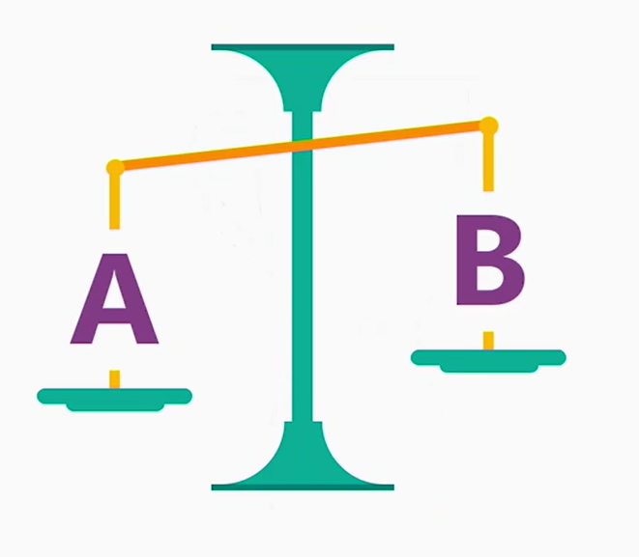
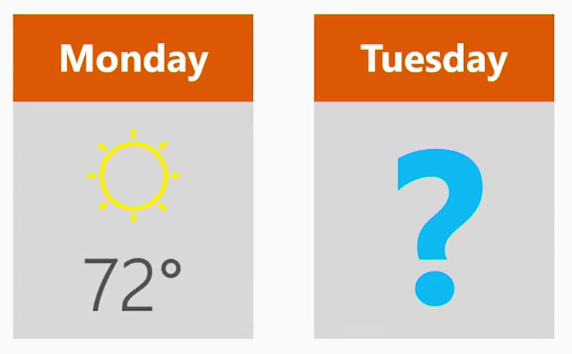
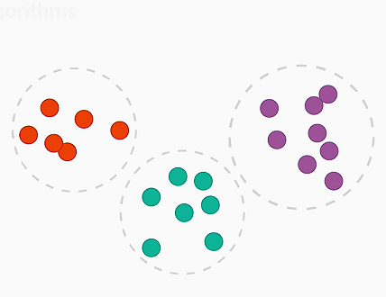
Many ML Tasks…
Is this A or B?
How much? How many?
How is this organized?
Classification
Regression
Clustering

Slide 10

How .NET team uses ML

Slide 11



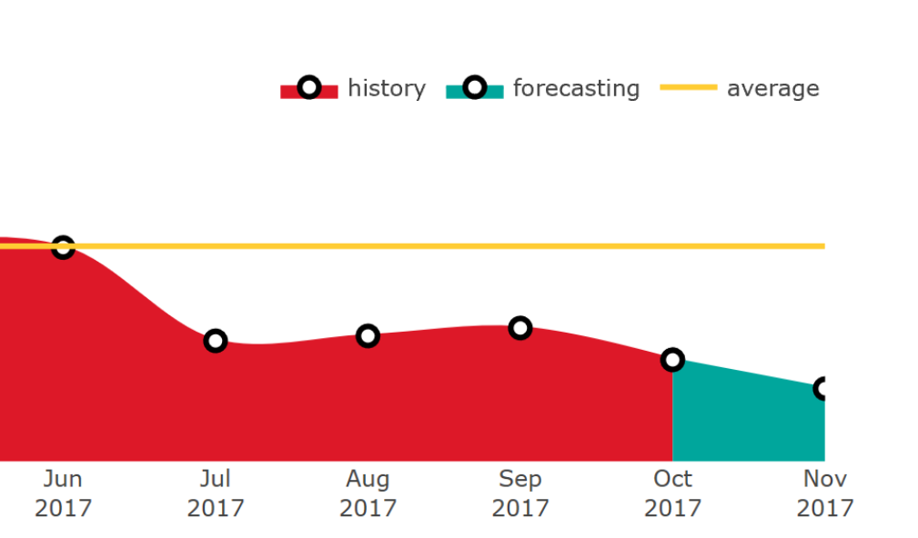
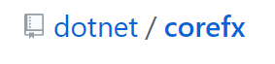
Solve three problems with
Issue Classification
Flight Delays
Sales Forecasting

Slide 12
01
WHAT IS ML.NET?
ML.NET is for building your own ML models

Slide 13





Pre-built ML Models (Azure Cognitive Services)
e.g. Sentiment Analysis using Azure Cognitive Services
TextAnalyticsAPI client = new TextAnalyticsAPI();
client.AzureRegion = AzureRegions.Westus;
client.SubscriptionKey = "1bf33391DeadFish"; client.Sentiment(
new MultiLanguageBatchInput(
new List<MultiLanguageInput>()
{
new MultiLanguageInput("en","0", "This is a great vacuum cleaner")
}));
Vision
Speech
Language
Labs
Knowledge
Search
96% positive
Consume (C#, VB, F#)
Easy / Less Control
Full Control / Harder

Slide 14
Pre-built ML Models (Azure Cognitive Services)
e.g. Sentiment Analysis using Azure Cognitive Services
TextAnalyticsAPI client = new TextAnalyticsAPI();
client.AzureRegion = AzureRegions.Westus;
client.SubscriptionKey = "1bf33391DeadFish"; client.Sentiment(
new MultiLanguageBatchInput(
new List<MultiLanguageInput>()
{
new MultiLanguageInput("en","0", "This vacuum cleaner sucks so much dirt")
}));
Vision
Speech
Language
Labs
Knowledge
Search
9% positive
Consume (C#, VB, F#)
Easy / Less Control
Full Control / Harder

Slide 15
Build your own (custom) ML Models
Prepare Your Data
Build & Train
Run
Full Control / Harder
Easy / Less Control

Slide 16
Build your own (custom) ML Models
Existing Solutions
Python, R are great for ML and Data Science
ML.NET is another way to do it with familiar tools
.NET currently lacks ML libraries and ML essentials
ML.NET complements the experience that AML, CogSvcs provides
Build your own
Code First approach
AppLocal Model deployment
Less Control / Easy

Slide 17
02
WHAT IS ML.NET?
ML.NET is a framework first

Slide 18



ML.NET is a framework first
Developer friendly APIs for Machine Learning
Training
Consumption
Extensions
Transforms
Learners
Misc.
Natural Text
Linear
ML Data framework
Schema
Boosted Trees
Evaluators
Missing values
Svm
Calibrators
Categorical
K-Means
Data loaders
Normalization
Feature Selection

Slide 19
03
WHAT IS ML.NET?
ML.NET has been proven in large scale Microsoft products

Slide 20


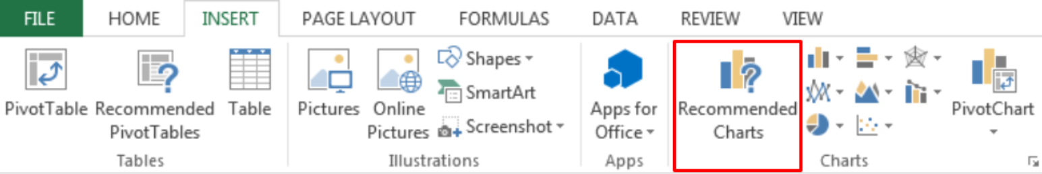

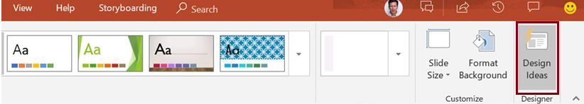

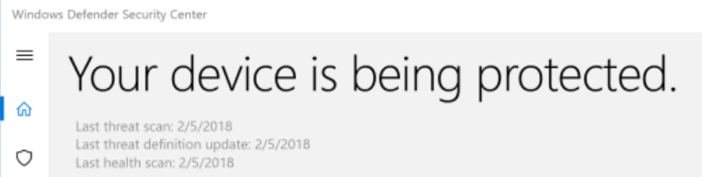
ML.NET Usage at Microsoft
Bing Ads
Excel
Power Point
Windows 10
+ more!

Slide 21
04
WHAT IS ML.NET?
ML.NET is Open Source
& Cross-Platform

Slide 22




ML.NET 0.1 (Preview)
Machine Learning framework made for .NET developers
Supported on Windows, Linux, and macOS
Build your own
Developer Focused
Proven & Extensible
Open Source
https://github.com/dotnet/machinelearning

Slide 23
GitHub Issue Tagger

Slide 24

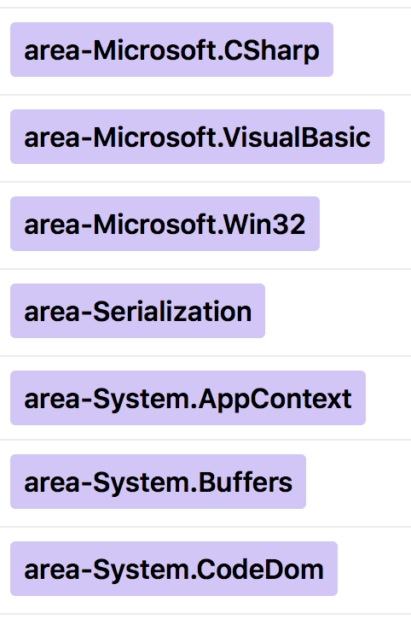
GitHub Issue Tagger (Classification Problem)
Is this A or B?
Which label should this issue be assigned?

Slide 25
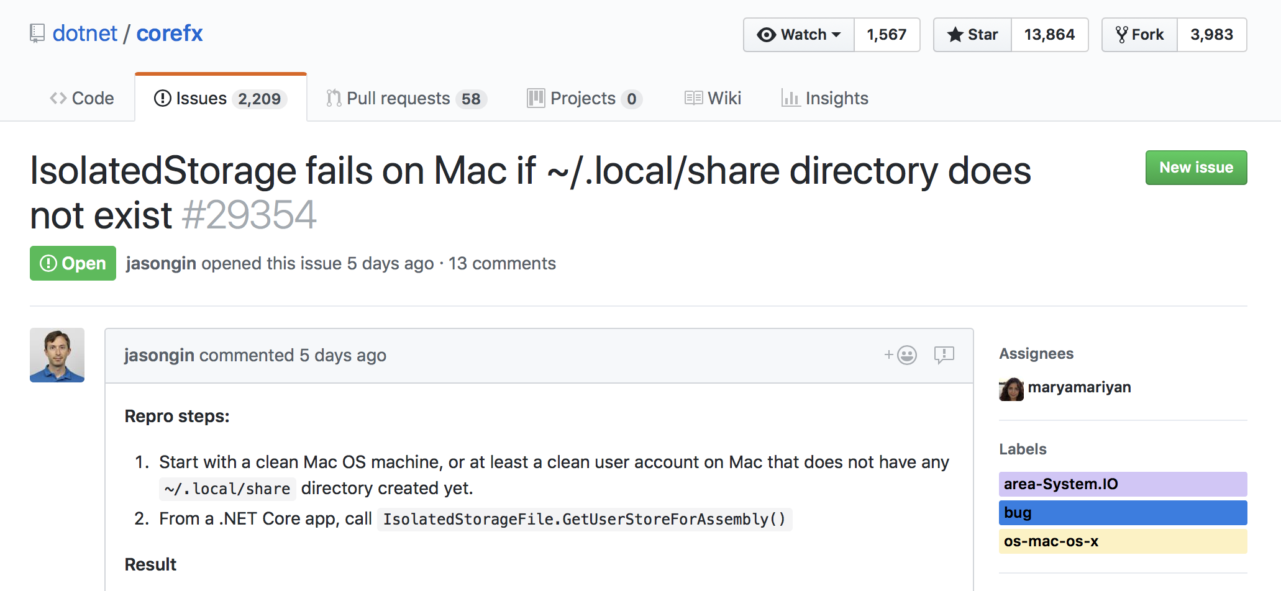
ML Models (GitHub Issue Classifier)

Slide 26
ML Models (GitHub Issue Classifier)
Features
Title
Description

Slide 27
ML Models (GitHub Issue Classifier)
Labels

Slide 28
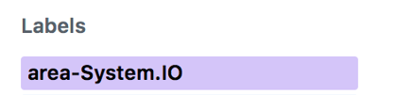
ML Models (GitHub Issue Classifier)
Training
Features
Title
Description
Train()
Model
Label

Slide 29
ML Models (GitHub Issue Classifier)
Prediction
Model.Predict()
Features
Predicted Label
Title
Description

Slide 30
End to End ML Workflow
Load Data
Extract Features
Train Model
Evaluate Model
Model consumption
ML Pipeline
labels + plain text
labels + feature vectors
model

Slide 31
End to End ML Workflow
Load Data
Extract Features
Train Model
Evaluate Model
Model consumption
ML Pipeline
labels + plain text
labels + feature vectors
model
Enter...
LearningPipelines!
in ML.NET

Slide 32
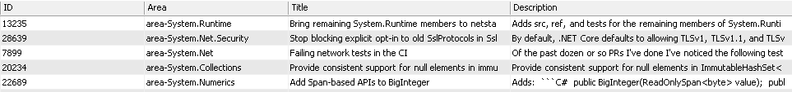
Load Data (Pipelines in ML.NET)
Collect GitHub issues using the C# API
corefx_issues.tsv (16K issues, Aug 2014 – Apr 2018)
Load Data
Extract Features
Train Model
Evaluate Model
Model consumption

Slide 33
Load Data (Pipelines in ML.NET)
var pipeline = new LearningPipeline();
Load Data
Extract Features
Train Model
Evaluate Model
Model consumption

Slide 34
Extract Features (Pipelines in ML.NET)
var pipeline = new LearningPipeline(); pipeline.Add(new TextLoader<CoreFxIssue>("../corefx_issues.tsv", useHeader: true));
class CoreFxIssue
{
[Column(ordinal: "0")]
public string ID;
[Column(ordinal: "1")]
public string Area;
[Column(ordinal: "2")]
public string Title;
[Column(ordinal: "3")]
public string Description;
}
Load Data
Extract Features
Train Model
Evaluate Model
Model consumption

Slide 35
Extract Features (Pipelines in ML.NET)
var pipeline = new LearningPipeline(); pipeline.Add(new TextLoader<CoreFxIssue>("../corefx_issues.tsv", useHeader: true));
ID | Area | Title | Description
7899 | area-System.Net | Failing network tests in the CI | Of the past dozen or so PRs I’ve …
Load Data
Extract Features
Train Model
Evaluate Model
Model consumption

Slide 36
Extract Features (Pipelines in ML.NET)
var pipeline = new LearningPipeline(); pipeline.Add(new TextLoader<CoreFxIssue>("../corefx_issues.tsv", useHeader: true));
pipeline.Add(new Dictionarizer(("Area", "Label“)));
ID | Area | Title | Description | Label
7899 | area-System.Net | Failing network tests in the CI | Of the past dozen or so PRs I’ve …
7899 | area-System.Net | Failing network tests in the CI | Of the past dozen or so PRs I’ve … | 5
Load Data
Extract Features
Train Model
Evaluate Model
Model consumption

Slide 37
Extract Features (Pipelines in ML.NET)
var pipeline = new LearningPipeline(); pipeline.Add(new TextLoader<CoreFxIssue>("../corefx_issues.tsv", useHeader: true));
pipeline.Add(new Dictionarizer(("Area", "Label")));
pipeline.Add(new TextFeaturizer("Title", "Title"));
ID | Area | Title | Description | Label
7899 | area-System.Net | Failing network tests in the CI | Of the past dozen or so PRs I’ve …
7899 | area-System.Net | Failing network tests in the CI | Of the past dozen or so PRs I’ve … | 5
7899 | area-System.Net | <0.45,0.34, …> | Of the past dozen or so PRs I’ve … | 5
Load Data
Extract Features
Train Model
Evaluate Model
Model consumption

Slide 38
Extract Features (Pipelines in ML.NET)
var pipeline = new LearningPipeline(); pipeline.Add(new TextLoader<CoreFxIssue>("../corefx_issues.tsv", useHeader: true));
pipeline.Add(new Dictionarizer(("Area", "Label")));
pipeline.Add(new TextFeaturizer("Title", "Title"));
pipeline.Add(new TextFeaturizer("Description", "Description"));
ID | Area | Title | Description | Label
7899 | area-System.Net | Failing network tests in the CI | Of the past dozen or so PRs I’ve …
7899 | area-System.Net | Failing network tests in the CI | Of the past dozen or so PRs I’ve … | 5
7899 | area-System.Net | <0.45,0.34, …> | Of the past dozen or so PRs I’ve … | 5
7899 | area-System.Net | <0.45,0.34, …> | <0.27, 0.54, … > | 5
Load Data
Extract Features
Train Model
Evaluate Model
Model consumption

Slide 39
Extract Features (Pipelines in ML.NET)
var pipeline = new LearningPipeline(); pipeline.Add(new TextLoader<CoreFxIssue>("../corefx_issues.tsv", useHeader: true));
pipeline.Add(new Dictionarizer(("Area", "Label")));
pipeline.Add(new TextFeaturizer("Title", "Title"));
pipeline.Add(new TextFeaturizer("Description", "Description"));
pipeline.Add(new ColumnConcatenator("Features", "Title", "Description"));
ID | Area | Title | Description | Label | Features
7899 | area-System.Net | Failing network tests in the CI | Of the past dozen or so PRs I’ve …
7899 | area-System.Net | Failing network tests in the CI | Of the past dozen or so PRs I’ve … | 5
7899 | area-System.Net | <0.45,0.34, …> | Of the past dozen or so PRs I’ve … | 5
7899 | area-System.Net | <0.45,0.34, …> | <0.27, 0.54, … > | 5
7899 | area-System.Net | <0.45,0.34, …> | <0.27, 0.54, … > | 5 | <0.45,0.34, …, 0.27, 0.54, …>
Load Data
Extract Features
Train Model
Evaluate Model
Model consumption

Slide 40
Train Model (Pipelines in ML.NET)
Train model takes ‘Labels + Features’ and produces a Model Object
pipeline.Add(new StochasticDualCoordinateAscentClassifier());
pipeline.Add(new PredictedLabelColumnOriginalValueConverter() { PredictedLabelColumn = "PredictedLabel" });
Load Data
Extract Features
Train Model
Evaluate Model
Model consumption

Slide 41
Train Model (Pipelines in ML.NET)
Train model takes ‘Labels + Features’ and produces a Model Object
pipeline.Add(new StochasticDualCoordinateAscentClassifier());
pipeline.Add(new PredictedLabelColumnOriginalValueConverter() { PredictedLabelColumn = "PredictedLabel" });
PredictionModel<CoreFxIssue, CoreFxIssuePrediction> model = pipeline.Train<CoreFxIssue, CoreFxIssuePrediction>();
public class CoreFxIssuePrediction
{
[ColumnName("PredictedLabel")]
public string Area;
}
Load Data
Extract Features
Train Model
Evaluate Model
Model consumption

Slide 42
Model Evaluation
Model must be valuable on new data (generalization)
Evaluate on test data: labeled data not used for training
Micro-accuracy: what percent of examples in test data are predicted correctly?
var testData = new TextLoader<CoreFxIssue>(@“..\corefx_issues_test.tsv", useHeader: true);
var evaluator = new ClassificationEvaluator(); ClassificationMetrics metrics = evaluator.Evaluate(model, testData); Console.WriteLine("Micro-Accuracy is {0}", metrics.AccuracyMicro);
Load Data
Extract Features
Train Model
Evaluate Model
Model consumption

Slide 43
Model Evaluation
Micro-accuracy: ~73%
Label | Accuracy
area-System.Net | 0.9691
area-System.Data | 0.9163
area-System.Linq | 0.8930
area-Serialization | 0.8799
area-System.IO | 0.8755
… | …
area-System.Numerics | 0.7588
area-System.Threading | 0.7184
area-System.Reflection | 0.6514
area-System.Globalization | 0.6494
area-Meta | 0.2325
Load Data
Extract Features
Train Model
Evaluate Model
Model consumption

Slide 44
Model Consumption
CoreFxIssue issue = new CoreFxIssue
{
ID = “7899",
Title = "Failing network tests in the CI",
Description = @"Of the past dozen or so PRs …"
};
CoreFxIssuePrediction prediction = model.Predict(issue);
Console.WriteLine("Area-Tag is " + prediction.Area);
Load Data
Extract Features
Train Model
Evaluate Model
Model consumption

Slide 45
Machine Learning is Iterative
Load Data
Extract Features
Train Model
Evaluate Model
Model consumption
ML Pipeline

Slide 46
Improving the model
More/different data
Larger dataset
User profiles
Different pipeline
Different learner
Different transforms
Different repositories
Different hyperparameters
“Programming the Unprogrammable” “Programming the Unprogrammable”

Slide 47
All About Pipelines!
(Taxi Fare)

Slide 48
1
2
3
4
5
6
Pipeline Games !
var pipeline = new LearningPipeline();
pipeline.Train<TaxiTrip, TaxiTripFarePrediction>();
pipeline.Add(new ColumnConcatenator("Features", "vendor_id", "rate_code", …);
pipeline.Add(new TextLoader<TaxiTrip> (DataPath, useHeader: true, separator: ","));
pipeline.Add(new FastTreeRegressor());
pipeline.Add(new CategoricalOneHotVectorizer ("vendor_id",
"rate_code",
"payment_type"));

Slide 49
2
3
4
5
6
Pipeline Games !
1
var pipeline = new LearningPipeline();
pipeline.Train<TaxiTrip, TaxiTripFarePrediction>();
pipeline.Add(new ColumnConcatenator("Features", "vendor_id", "rate_code", …);
pipeline.Add(new TextLoader<TaxiTrip> (DataPath, useHeader: true, separator: ","));
pipeline.Add(new FastTreeRegressor());
pipeline.Add(new CategoricalOneHotVectorizer ("vendor_id",
"rate_code",
"payment_type"));

Slide 50
3
4
5
6
Pipeline Games !
1
var pipeline = new LearningPipeline();
pipeline.Train<TaxiTrip, TaxiTripFarePrediction>();
pipeline.Add(new ColumnConcatenator("Features", "vendor_id", "rate_code", …);
2
pipeline.Add(new TextLoader<TaxiTrip> (DataPath, useHeader: true, separator: ","));
pipeline.Add(new FastTreeRegressor());
pipeline.Add(new CategoricalOneHotVectorizer ("vendor_id",
"rate_code",
"payment_type"));

Slide 51
4
5
6
Pipeline Games !
1
var pipeline = new LearningPipeline();
pipeline.Train<TaxiTrip, TaxiTripFarePrediction>();
pipeline.Add(new ColumnConcatenator("Features", "vendor_id", "rate_code", …);
2
pipeline.Add(new TextLoader<TaxiTrip> (DataPath, useHeader: true, separator: ","));
pipeline.Add(new FastTreeRegressor());
3
pipeline.Add(new CategoricalOneHotVectorizer ("vendor_id",
"rate_code",
"payment_type"));

Slide 52
5
6
Pipeline Games !
1
var pipeline = new LearningPipeline();
pipeline.Train<TaxiTrip, TaxiTripFarePrediction>();
4
pipeline.Add(new ColumnConcatenator("Features", "vendor_id", "rate_code", …);
2
pipeline.Add(new TextLoader<TaxiTrip> (DataPath, useHeader: true, separator: ","));
pipeline.Add(new FastTreeRegressor());
3
pipeline.Add(new CategoricalOneHotVectorizer ("vendor_id",
"rate_code",
"payment_type"));

Slide 53
6
Pipeline Games !
1
var pipeline = new LearningPipeline();
pipeline.Train<TaxiTrip, TaxiTripFarePrediction>();
4
pipeline.Add(new ColumnConcatenator("Features", "vendor_id", "rate_code", …);
2
pipeline.Add(new TextLoader<TaxiTrip> (DataPath, useHeader: true, separator: ","));
5
pipeline.Add(new FastTreeRegressor());
3
pipeline.Add(new CategoricalOneHotVectorizer ("vendor_id",
"rate_code",
"payment_type"));

Slide 54
Pipeline Games !
1
var pipeline = new LearningPipeline();
6
pipeline.Train<TaxiTrip, TaxiTripFarePrediction>();
4
pipeline.Add(new ColumnConcatenator("Features", "vendor_id", "rate_code", …);
2
pipeline.Add(new TextLoader<TaxiTrip> (DataPath, useHeader: true, separator: ","));
5
pipeline.Add(new FastTreeRegressor());
3
pipeline.Add(new CategoricalOneHotVectorizer ("vendor_id",
"rate_code",
"payment_type"));

Slide 55
Pipeline Games !
var pipeline = new LearningPipeline();
pipeline.Add(new TextLoader<TaxiTrip> (DataPath, useHeader: true, separator: ","));
pipeline.Add(new CategoricalOneHotVectorizer ("vendor_id",
"rate_code",
"payment_type"));
pipeline.Add(new ColumnConcatenator("Features", "vendor_id", "rate_code", …);
pipeline.Add(new FastTreeRegressor());
pipeline.Train<TaxiTrip, TaxiTripFarePrediction>();

Slide 56
Road Ahead for ML.NET
API improvements
Additional ML Tasks and Scenarios
Deep Learning (TensorFlow, CNTK)
ONNX support for WinML
Scale-out on Azure
Better GUI to simplify ML tasks
Integration with VS Tools for AI
Language Innovation for .NET

Slide 57
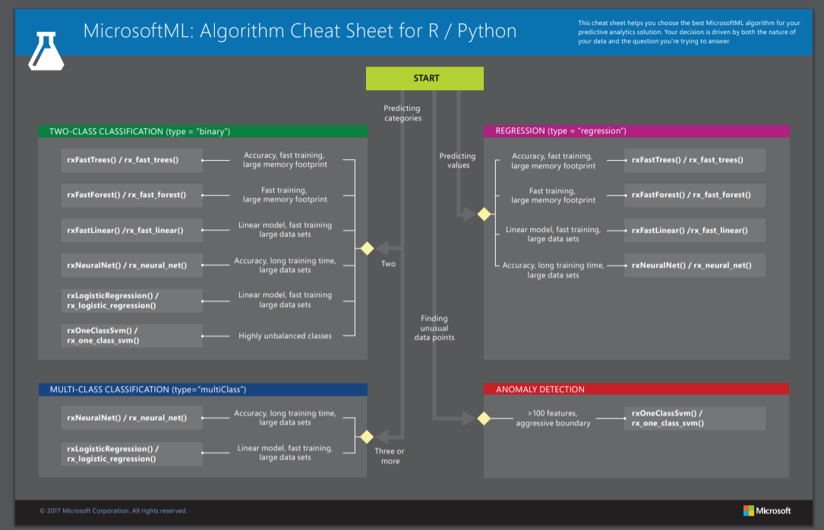

Slide 58
https://docs.microsoft.com/en-us/dotnet/api/microsoft.ml.trainers?view=ml-dotnet

Slide 59
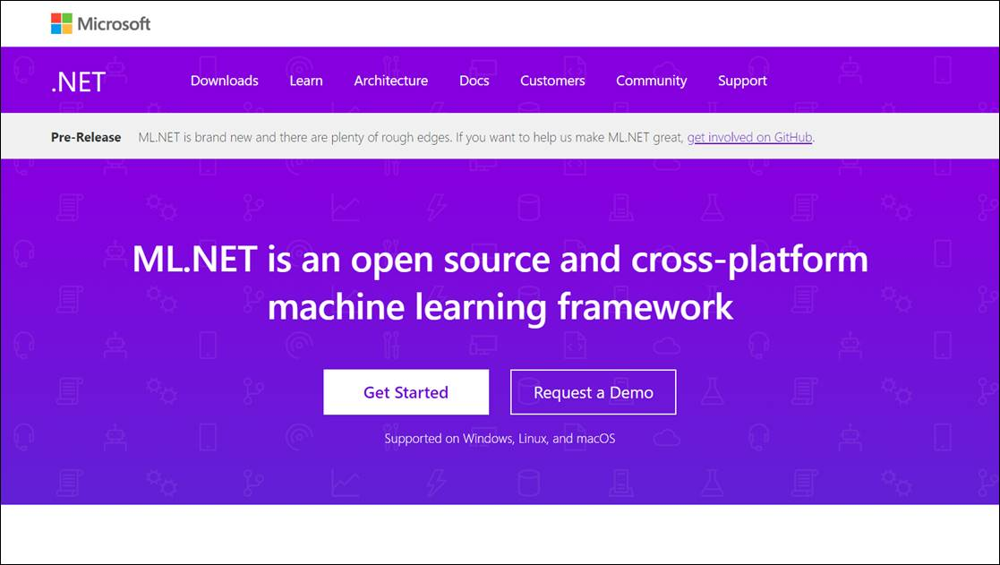
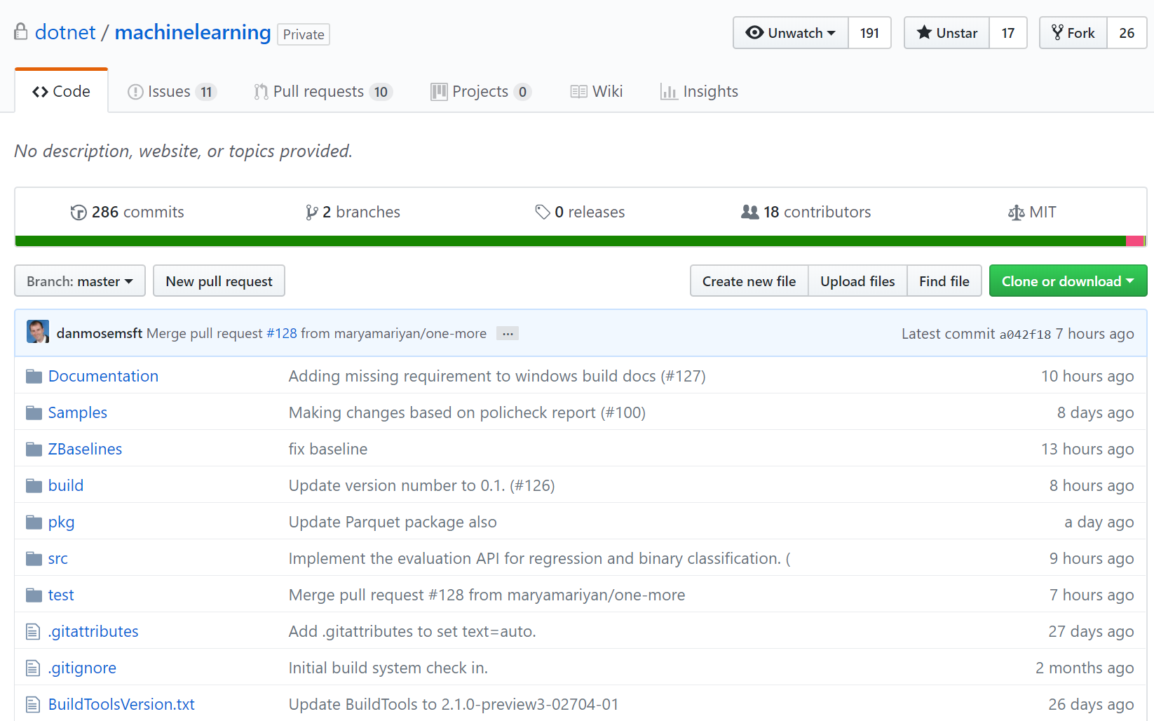
Help us make ML.NET Great!
Get Started dot.net/ml
Get Involved
https://github.com/dotnet/machinelearning/

